Slide 1
College Life and Sleep Quality
Data analysis by Ren Bannon

Slide 2
Core Questions
How well do different demographics (specifically gender) tend to sleep?
How does sleep correlate with mental health?
How can the quality of one’s sleep impact their mental health?
How does poor sleep tend to affect grades?

Slide 3

Demographics: Gender (Sleep Quality)
Between males and females, on average males in the study had a slightly worse sleep quality than the females who participated.
Of those surveyed, males were on average more depressed than females
Females, however, were on average more anxious and stressed. Additionally, females scored worse for overall mental health (average of Depression/Anxiety/Stress) despite having better sleep quality than males.
On average, females had a higher GPA than males.

Slide 4
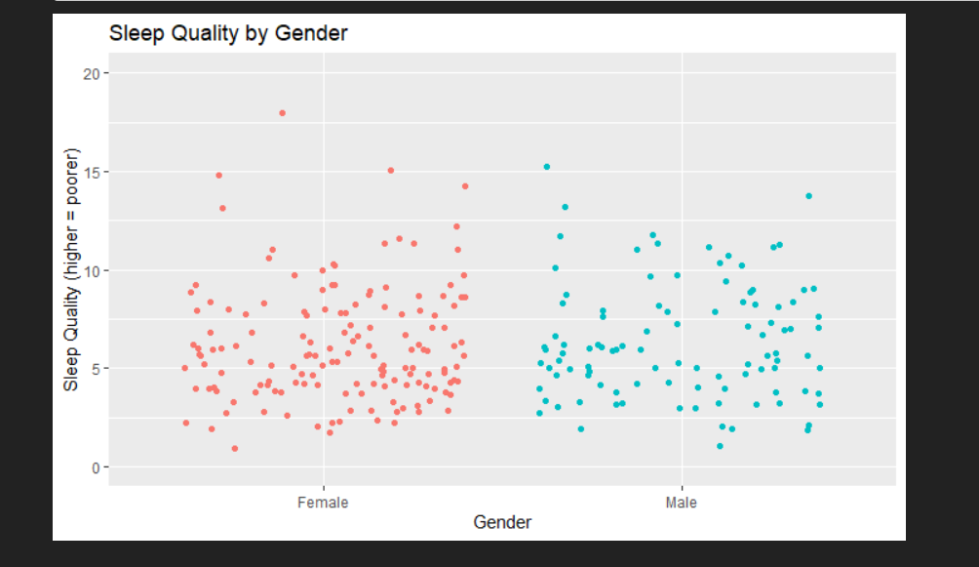
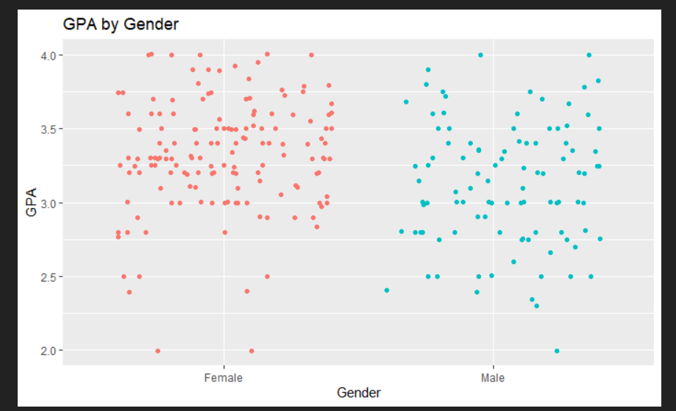
Demographics: Gender (Visualizers)

Slide 5
Demographics: Gender (Takeaway)
Females had a better sleep quality and GPA than males on average
However, females also had worse anxiety and stress, as well as a worse average overall mental health. They were, however, less depressed than males
I find this interesting, as even though females did have worse mental health on average, anxiety and stress can often be harnessed for productive purposes, whereas depressive feelings often inhibit productivity.

Slide 6
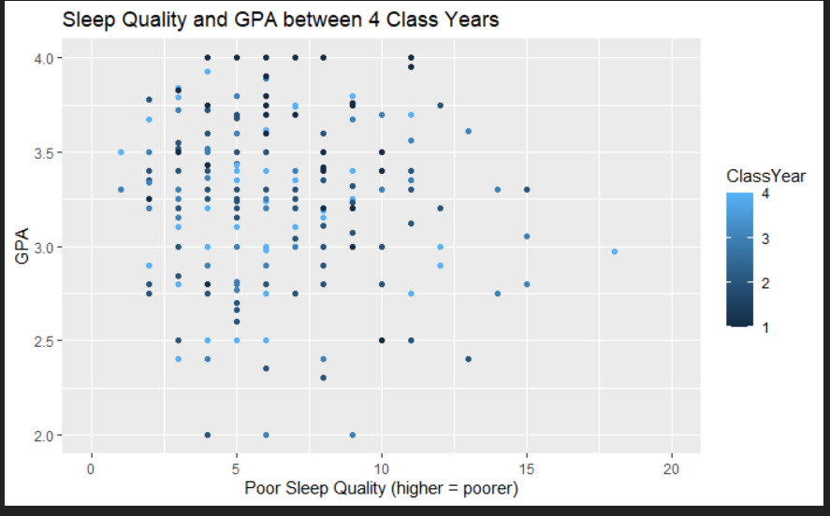
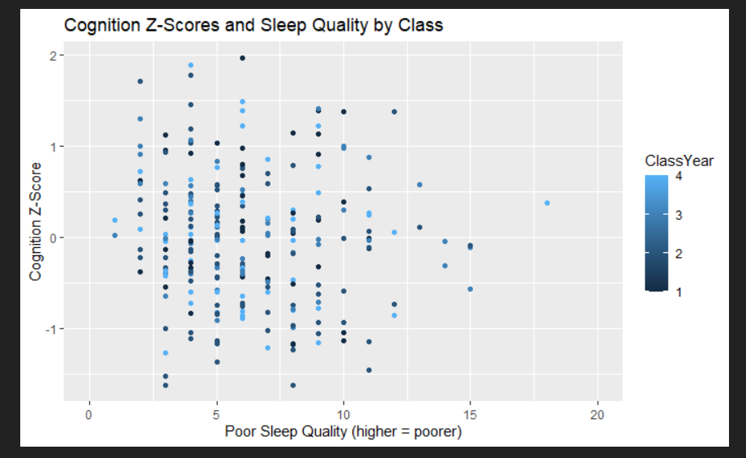
Sleep: GPA and cognitive ability
As one would expect, poor sleep quality and GPA are negatively correlated.
As sleep quality worsens, the smaller the concentration of GPAs above 3.0
Similarly, as sleep quality worsens, Cognition Z-scores trend downwards

Slide 7
Sleep: Mental Health
Poor sleep quality and the Depression/Anxiety/Stress score provided by the dataset were positively correlated.
The D/A/S score trended upwards as sleep quality worsened, meaning overall mental health was worsened for the study participants
Two implications: Poorer mental health leads to worse sleep, Worse sleep leads to poorer mental health, or both!

Slide 8
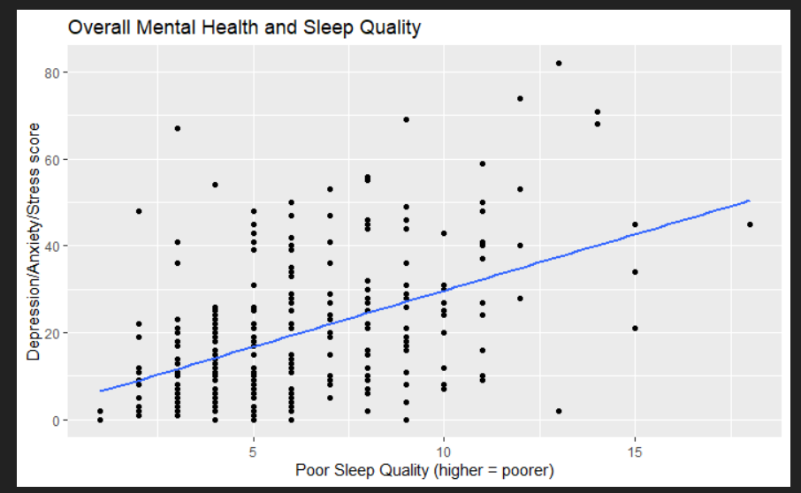
Sleep: Mental Health (Visualizer)

Slide 9
Answering the Core Questions
Q: How well do different demographics (specifically gender) tend to sleep?
A: On average, female participants had a better quality of sleep than male participants.
Q: How does sleep correlate with mental health?
A: As the quality of sleep declines, overall mental health tends to worsen
Q: How can the quality of one’s sleep impact their cognitive function?
A: Lower quality sleep was accompanied by a downward trend in cognitive Z-scores
Q: How does poor sleep tend to affect grades?
A: As sleep quality worsened, a downward trend in GPAs was noticable

Slide 10
Conclusion
College living is often one’s first brush with adulthood, and this comes with many burdens
Sleep-deprivation is seen as a commonality in what is called ‘crunch culture”, which is a common aspect of student life
The effects of this culture often go under-appreciated, and it’s wonderful to have tangible data to demonstrate what sleep, or lack thereof), can really do to one’s mind.

